Slide 1
The sorting problem
Input: a list of n elements
Output: the same list of n elements rearranges in increasing (non decreasing) or decreasing (non increasing) order
Why do we care so much about sorting?
sorting is used by many applications
Sorting is initial step of many algorithms
many techniques can be illustrated by studying sorting

Slide 2
Selection sort
How does it work:
  first find the smallest in the array and exchange it with the element in the first position, then find the second smallest element and exchange it with the element in the second position, and continue in this way until the entire array is sorted.
How does it sort the list in a non increasing order?
Selection sort is:
  The simplest sorting techniques.
  a good algorithm to sort a small number of elements
  an incremental algorithm – induction method
Selection sort is Inefficient for large lists.
Incremental algorithms → process the input elements one-by-one and maintain the solution for the elements processed so far.

Slide 3
Selection Sort Algorithm
Input: An array A[1..n] of n elements.
Output: A[1..n] sorted in nondecreasing order.
1. for i ← 1 to n - 1
2. k ← i
3. for j ← i + 1 to n {Find the i th smallest element.}
4. if A[j] < A[k] then k ← j
5. end for
6. if k ≠ i then interchange A[i] and A[k]
7. end for

Slide 4
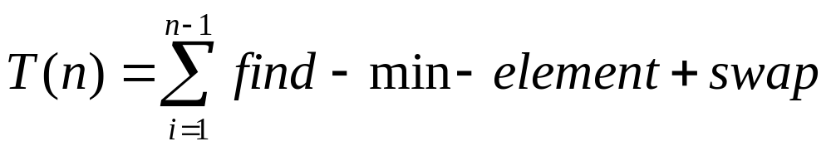
Analysis of Algorithms
Algorithm analysis: quantify the performance of the algorithm, i.e., the amount of time and space taken in terms of n.
T(n) is the total number of accesses made from the beginning of selection_sort until the end.
selection_sort itself simply calls swap and find_min_index as i goes from 1 to n-1
= n-1 + n-2 + n-3 + … + 1 = n(n-1)/2
Or = ∑ (n - i) = n (n - 1) / 2 -→ O(n²)

Slide 5
INSERTIONSORT
Insertion sort keeps making the left side of the array sorted until the whole array is sorted.
Real life example:
  An example of an insertion sort occurs in everyday life while playing cards. To sort the cards in your hand you extract a card, shift the remaining cards, and then insert the extracted card in the correct place.

Slide 6
Algorithm: INSERTIONSORT
Input: An array A[1..n] of n elements.
Output: A[1..n] sorted in nondecreasing order.
1. for i ← 2 to n
2. x ← A[i]
3. j ← i - 1
4. while (j >0) and (A[j] > x)
5. A[j + 1] ← A[j]
6. j ← j - 1
7. end while
8. A[j + 1] ← x
9. end for
Example sort : 34 8 64 51 32 21

Slide 7
A[i] is inserted in its proper position in the ith iteration in the sorted subarray A[1 .. i-1]
In the ith step, the elements from index i-1 down to 1 are scanned, each time comparing A[i] with the element at the correct position.
In each iteration an element is shifted one position up to a higher index.
The process of comparison and shifting continues until:
  Either an element ≤ A[i] is found or
  When all the sorted sequence so far is scanned.
Then A[i] is inserted in its proper position.

Slide 8
Analysis
Let a₀, ..., a_{n-1} be the sequence to be sorted. At the beginning and after each iteration of the algorithm the sequence consists of two parts: the first part a₀, ..., a_{i-1} is already sorted, the second part a_{i}, ..., a_{n-1} is still unsorted (i in 0, ..., n).
The worst case occurs when in every step the proper position for the element that is inserted is found at the beginning of the sorted part of the sequence.

Slide 9
The minimum # of element comparisons (best case) occurs when the array is already sorted in nondecreasing order. In this case, the # of element comparisons is exactly n - 1, as each element A[i], 2 ≤ i ≤ n, is compared with A[i - 1] only.
The maximum # of element comparisons (Worst case) occurs if the array is already sorted in decreasing order and all elements are distinct. In this case, the number is
n n-1
∑ (i – 1) = ∑ (i – 1) = n(n-1)/2
i =2 i =1
This is because each element A[i], 2 ≤ i ≤ n is
compared with each entry in subarray A[1 .. i-1]
➔ Pros: Relatively simple and easy to implement.
Cons: Inefficient for large lists.

Slide 10
Best case: O(n). It occurs when the data is in sorted order. After making one pass through the data and making no insertions, insertion sort exits.
Average case: θ(n²) since there is a wide variation with the running time.
Worst case: O(n²) if the numbers were sorted in reverse order.

Slide 11
Algorithm: MERGE
Input: An array A[1..m] of elements and three indices p, q and r, with 1 ≤ p ≤ q <r ≤ m, such that both the subarrays A[p..q] and A[q + 1..r] are sorted individually in nondecreasing order.
Output: A[p..r] contains the result of merging the two subarrays A[p..q] and A[q + 1..r].
1. comment: B[p..r] is an auxiliary array.
2. s ← p; t ← q + 1; k ← p
3. while s ≤ q and t ≤ r
4. if A[s] ≤ A[t] then
5. B[k] ← A[s]
6. s ← s + 1
7. else
8. B[k] ←A[t]
9. t ← t + 1
10. end if
11. k ← k + 1
12. end while
13. if s = q + 1then B[k..r] ← A[t..r]
14. else B[k..r] ← A[s..q]
15. end if
16. A[p..r] ← B[p..r]

Slide 12
Analysis
# of element Comparisons performed by Algorithm MERGE to merge two nonempty arrays of sizes n1 and n2, respectively into one sorted array of size n = n1 + n2 is between n1 and n - 1. In particular, # of comparisons needed is between n/2 and n - 1.
# of element Assignments: performed by Algorithm MERG to merge two nonempty arrays into one sorted array of size n is exactly 2n.
➔ time complexty = O(n)
➔Space complexity = O(n)

Slide 13
Merge Sort divide-and-conquer
Divide: divide the n-element sequence into two subproblems of n/2 elements each.
Conquer: sort the two subsequences recursively using merge sort. If the length of a sequence is 1, do nothing since it is already in order.
Combine: merge the two sorted subsequences to produce the sorted answer.

Slide 14
MERGE-SORT(A,p,r)
if lo < hi
then mid ← ⎣(lo+hi)/2⎦
MERGE-SORT(A,lo,mid)
MERGE-SORT(A,mid+1,hi)
MERGE(A,lo,mid,hi)
Call MERGE-SORT(A,1,n) (assume n=length of list A)
A = {10, 5, 7, 6, 1, 4, 8, 3, 2, 9}

Slide 15
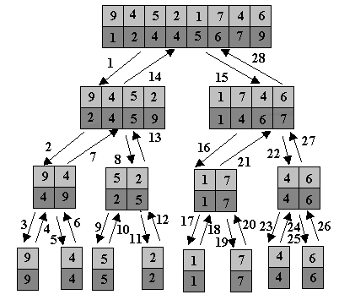

Slide 16
Analysis of Merge Sort
if lo < hi …………… 1
then mid ← ⎣(lo+hi)/2⎦ ……………. 1
MERGE-SORT(A,lo,mid) ……………. n/2
MERGE-SORT(A,mid+1,hi) …………… n/2
MERGE(A,lo,mid,hi) …………….n
Described by recursive equation
Suppose T(n) is the running time on a problem of size n.
T(n) = c if n=1
2T(n/2)+ cn if n>1

